Slide 1
What is MCP?
MCP is an open-source standard designed to connect AI applications.
Analogy: MCP is like a USB-C port for AI applications.
Enables AI apps to access:
Data sources (e.g., files, databases)
Tools/functionalities (e.g., workflows, APIs)
Workflows/prompts (templated interactions)

Slide 2
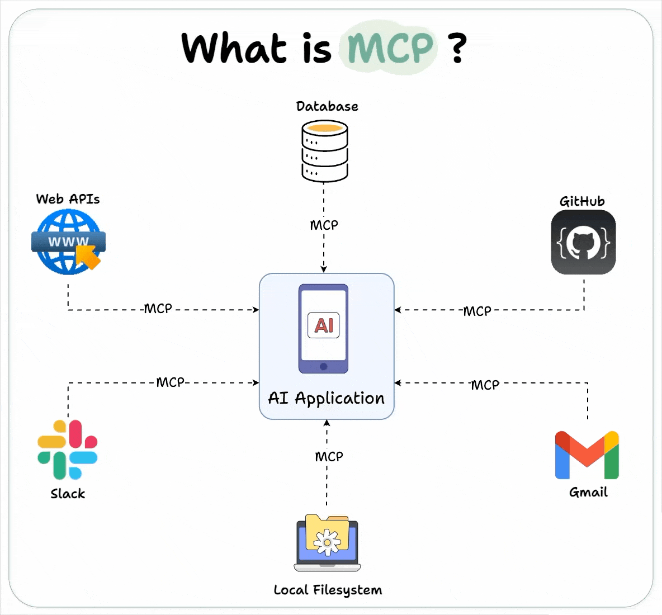
Model Context Protocol

